Slide 1




INDIAN MISSIONS ABROAD
Bharat Renewable
Energy Summit
& Expo 2026
International outreach toolkit
2–5 November 2026
Bharat Mandapam, New Delhi, India
Delegate participation and exhibition enquiries

Slide 2
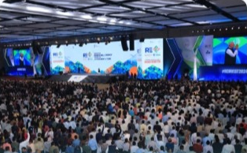
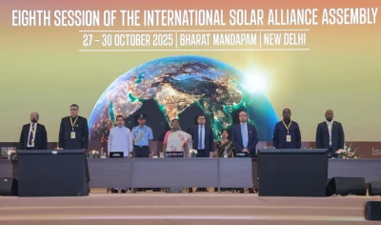
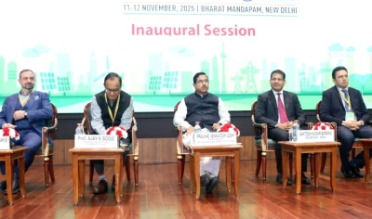
GLOBAL CLEAN ENERGY COOPERATION
Three flagship events. One shared vision.
Bharat Renewable Energy
Summit & Expo 2026
9th Session of the
International Solar Alliance
(ISA) Assembly
4th International Conference
on Green Hydrogen (ICGH)
An international platform connecting policy, industry and investment to accelerate renewable energy deployment.
ISA Member Countries advance solar cooperation and knowledge sharing to accelerate adoption worldwide.
A global forum on emerging technologies, policy and partnerships for the hydrogen economy.
BRE SUMMIT WEBSITE
ISA WEBSITE
MNRE HYDROGEN WEBSITE
BHARAT RE SUMMIT & EXPO 2026

Slide 3
EXPECTED SCALE AND PARTICIPATION
Summit at a glance
75,000+
BHARAT RE SUMMIT
& EXPO 2026
Participants expected
2–5 November • New Delhi
75+
250+
500+
80+
Countries participating
High-level delegates
Speakers
Technical sessions, policy
sessions & industry
roundtables
BHARAT RE SUMMIT & EXPO 2026

Slide 4
THE CASE FOR INTERNATIONAL PARTICIPATION
Business opportunities through BRE Summit 2026
How the Summit can help
INDIA’S CLEAN ENERGY LEADERSHIP
01
Access India’s clean energy market
Meet policymakers, project developers, utilities and industry leaders. Identify partners for market entry, manufacturing, distribution and project delivery.
Position your organisation at the centre of the global renewable energy conversation.
02
Build investment and project connections
Engage investors, financial institutions and developers across solar, storage, wind, hydrogen, bioenergy, DRE and small hydropower.
03
Showcase technology and generate leads
Use the Expo to present products and solutions, strengthen visibility and develop qualified business enquiries.
India combines market scale, policy momentum, manufacturing capability and international partnerships. The Summit brings this ecosystem together in New Delhi.
04
Gain policy and market insight
Understand India’s priorities in green finance, grid integration, digitalisation, supply chains and skills.
MISSION ROLE
Mobilise business delegations, country or sector pavilions, B2B introductions
BHARAT RE SUMMIT & EXPO 2026

Slide 5
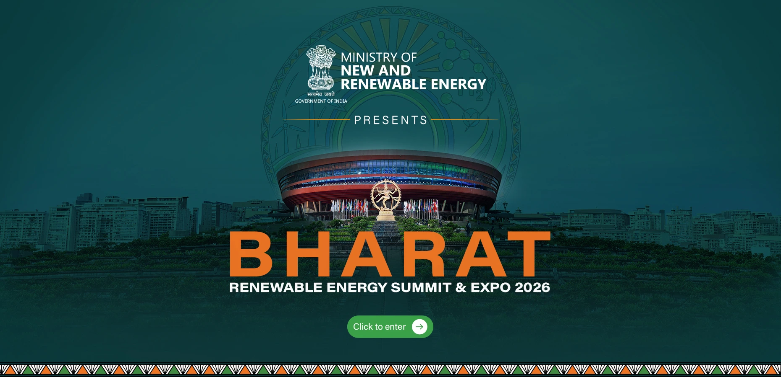
WEBSITE HOSTING
Summit visibility on mission websites
Recommended placement
Display the banner prominently on the mission homepage and link it directly to bresummit.in.
Supporting content
Add a Summit entry under “What’s New” or trade events, with a brief introduction, brochure downloads and participation links.
HOMEPAGE BANNER: LINKED TO THE OFFICIAL WEBSITE
Delegate registration
bresummit.in
Official homepage artwork
Exhibition enquiries
BHARAT RE SUMMIT & EXPO 2026

Slide 6
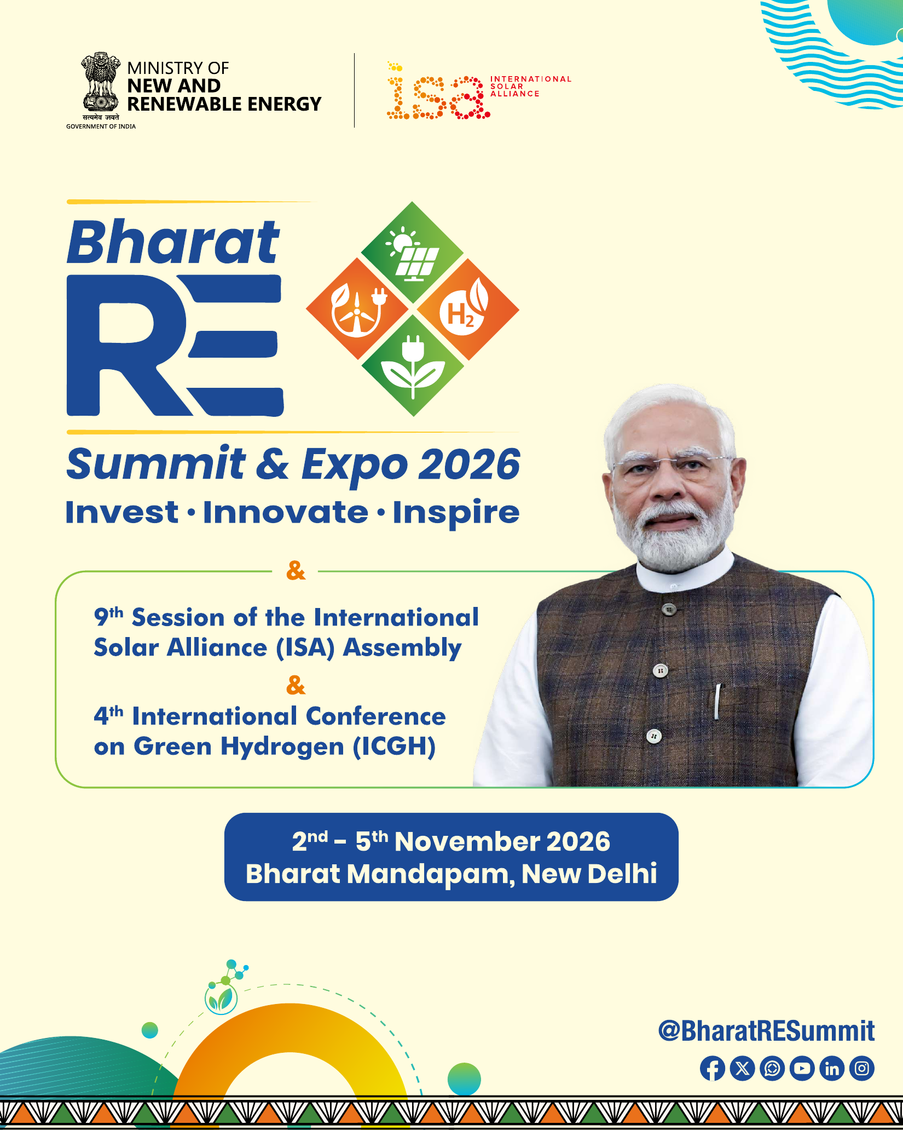
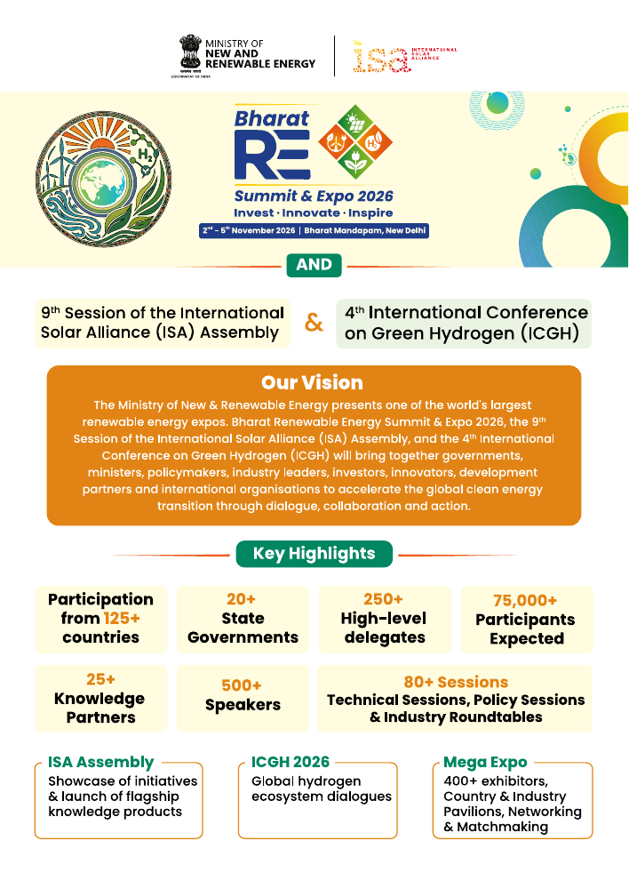

DOWNLOAD AND CIRCULATE
Official brochures and information resources
Summit brochure
Digital information brochure
Urja Chakra leaflet
Flagship invitation
Detailed event overview
India’s clean energy vision
Features the Hon’ble Prime Minister and the three co-located global platforms. Use for senior-level outreach.
Use for government, industry, investor and institutional engagement.
Use in diplomatic briefings and thematic conversations on India’s renewable energy approach.
BHARAT RE SUMMIT & EXPO 2026

Slide 7











COMPLETE WEBSITE THEME LIST
All Summit themes
Solar Energy & Global Solar Markets
Distributed Renewable Energy (DRE)
Energy Storage & Grid Integration
Green Hydrogen & Emerging Fuels
Investment & Green Financing
Bio Energy
Wind & Hybrid Energy Systems
Skill and Capacity Building & Role of Women in RE
Clean Energy Manufacturing & Supply Chains
Small Hydropower (SHP)
Digitalisation & AI in Energy
Mission use
Select themes that match local market priorities; retain the official wording.
BHARAT RE SUMMIT & EXPO 2026

Slide 8
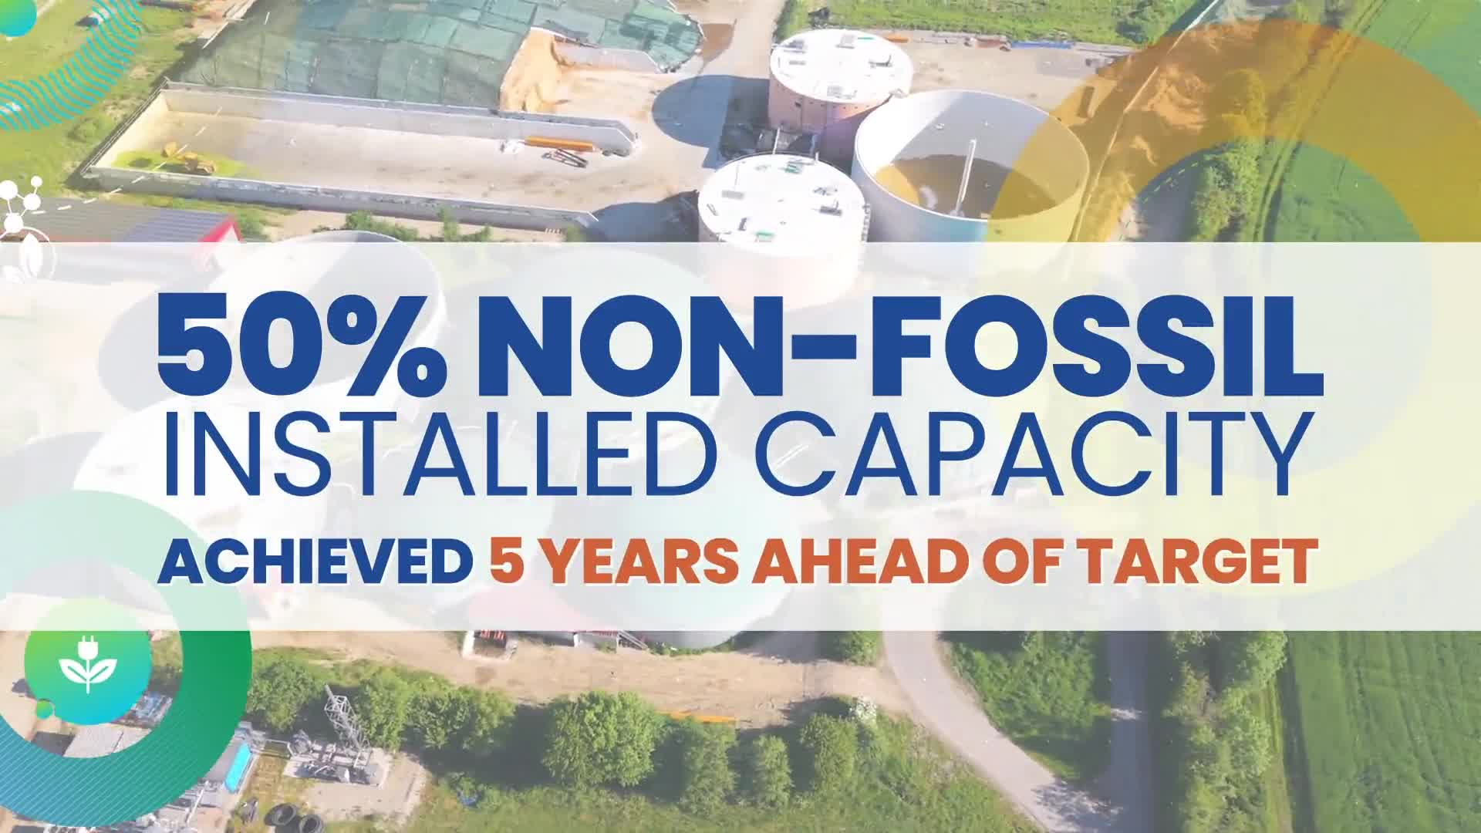


SCREEN IN BRIEFINGS AND SHARE THROUGH NETWORKS
Curtain Raiser films for mission outreach
Summit launch film
Curtain Raiser film
Curtain Raiser film
Bharat RE Summit & Expo 2026
Urja Chakra: The Reveal
The Digital Way
The vision, scale and international proposition of India’s flagship renewable energy platform.
The unveiling of Urja Chakra, representing India’s clean energy vision and global leadership.
An introduction to the Summit’s digital portal and mobile app for planning, updates and engagement.
WATCH FILM
WATCH FILM
WATCH FILM
BHARAT RE SUMMIT & EXPO 2026

Slide 9


PLAN, CONNECT AND RECEIVE LIVE UPDATES
BRE Summit 2026 mobile app
Promote the app through mission websites, registration confirmations and delegate briefings.
Recommended mission actions
Your Summit companion
01
Add both store links
Place the iOS and Android badges beside event registration information.
1
Build a personal schedule
02
Include in delegate emails
Encourage registered participants to download the app before travel.
2
Connect with delegates
3
Receive live updates
4
Access Summit information
03
Reshare at event opening
Use a concise post to drive real-time programme and networking use.
iOS
Android
Official store links
BHARAT RE SUMMIT & EXPO 2026

Slide 10





TAG, FOLLOW AND AMPLIFY
Official social handles and hashtags
Follow Official BRE Summit channels
Institutional accounts to tag when relevant
X
@BharatRESummit
IG
@bharatresummit
X
@mnreindia @isolaralliance @MEAIndia
Instagram
@bharatresummit @internationalsolaralliance
Bharat RE Summit
Bharat RE Summit
LinkedIn / Facebook
Tag the verified organisation pages by name.
in
f
Hashtag hierarchy
YT
Bharat RE Summit
#BRESummit2026
PRIMARY
Use the official BRE account as the primary tag.
#9ISAssembly2026
#ICGH2026
Campaign tags
#UrjaChakra #InvestInnovateInspire #VasudhaivaKutumbakam
BHARAT RE SUMMIT & EXPO 2026

Slide 11
REFERENCE SOCIAL BANNERS AND SAMPLE COPY
Before the Summit: invitations to participate
DELEGATE INVITATION
EXHIBITOR INVITATION
Official banner
Link to registration
Local-language caption
Expo proposition
Booth enquiry link
Chamber circulation
Join the global
clean energy
conversation
Your solutions.
An international
platform.
2–5 November 2026
Bharat Mandapam, New Delhi
Bharat RE Summit & Expo 2026
2–5 November, New Delhi
REGISTER AT BRESUMMIT.IN
ENQUIRE ABOUT BOOTH SPACE
Suggested post
Suggested post
Join Bharat RE Summit & Expo 2026 in New Delhi, 2–5 November. Explore clean energy opportunities and connect with international partners. Register today.
Showcase your clean energy solutions at Bharat RE Summit & Expo 2026. Explore exhibition opportunities in New Delhi, 2–5 November. Enquire about booth space.
BHARAT RE SUMMIT & EXPO 2026

Slide 12
SAMPLE POST FOR 2–5 NOVEMBER 2026
During the Summit: international engagement
Suggested post
Bharat RE Summit & Expo 2026 is underway in New Delhi. Follow the discussions on renewable energy, innovation and international cooperation, and explore the technologies on display at the Expo.
The clean energy
conversation is
happening now
OFFICIAL SUMMIT UPDATES
Bharat RE Summit & Expo 2026
2–5 November, New Delhi
Mission-led coverage
Share delegation visits and business interactions with a verified caption. Pair event photographs with one clear insight from the day.
FOLLOW OFFICIAL SUMMIT UPDATES
BHARAT RE SUMMIT & EXPO 2026 / INDIAN MISSIONS ABROAD

Slide 13
SAMPLE POST FOR PUBLICATION AFTER 5 NOVEMBER 2026
After the Summit: continued cooperation
Continuing the
clean energy conversation
BHARAT RE SUMMIT & EXPO 2026
Suggested post
Follow-up through mission networks
As Bharat RE Summit & Expo 2026 concludes, we thank participating organisations for contributing to the clean energy conversation. Explore the official highlights and continue discussions on opportunities for cooperation.
Circulate the official outcome summary and recordings. Reconnect interested organisations with the Summit team and relevant partners.
Add only confirmed outcomes and partnerships.
BHARAT RE SUMMIT & EXPO 2026

Slide 14
KEEP DELEGATE REGISTRATION AND EXHIBITION ENQUIRIES SEPARATE
Two distinct participation routes
01
REGISTER AS A DELEGATE
02
EXHIBIT / ENQUIRE ABOUT BOOTH SPACE
For policymakers, public agencies, investors, businesses, researchers and international organisations attending the Summit.
For renewable energy companies, technology providers, manufacturers, startups and country or sector pavilions.
Mission action
Mission action
Share the official registration portal and encourage early completion by priority stakeholders.
Direct prospects to the exhibitor page; request sector, indicative space and contact details for follow-up.
OPEN DELEGATE REGISTRATION
OPEN EXHIBITOR ENQUIRY
BHARAT RE SUMMIT & EXPO 2026

Slide 15
Connecting the World to India’s Clean Energy Opportunity
Indian Missions abroad can help bring international participation to Bharat RE Summit & Expo 2026 by sharing official resources, engaging government and industry networks, and facilitating delegate registrations and exhibition enquiries.
2–5 November 2026
Bharat Mandapam, New Delhi, India
Invest. Innovate. Inspire.

Slide 16
DIRECT EACH QUERY TO THE RELEVANT TEAM
Nodal Officer
Name : Aseem Kumar
Email : Aseemk201-cgo@gov.in
Phone number : 9557759492
Key contacts for Summit enquiries
EXHIBITIONS, BOOTH SPACE & EXPO INFORMATION
SESSIONS & PROGRAMME
NAME
Shri Tarun Singh
NAME
Shri Gaurav Mishra
DESIGNATION
Scientist-E
DESIGNATION
Scientist-F
EMAIL
tarun.singh@nic.in
EMAIL
gaurav.mishra76@gov.in
PHONE
9540710730
PHONE
9910096664
MEDIA, PRESS & SOCIAL MEDIA
REGISTRATION SUPPORT
NAME
Shri Saurabh Mukherjee
NAME
Shri Vikram Dhaka
DESIGNATION
Under Secretary
DESIGNATION
Scientist-D
EMAIL
saurabhmukherjee@edu.nic.in
EMAIL
vikram.mnre@gov.in
PHONE
9582527301
PHONE
7060334373
CENTRAL SUMMIT CONTACT
mail@bresummit.in
Use the official enquiry for any other query
OPEN ENQUIRY FORM
BHARAT RE SUMMIT & EXPO 2026
16

